Slide 1
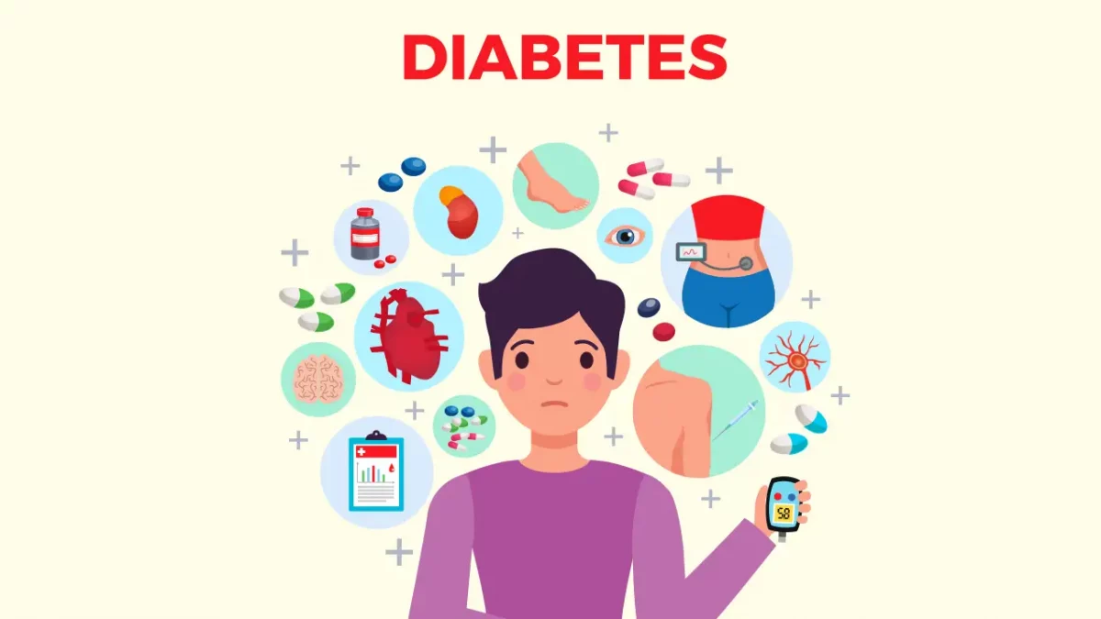
Diabetes Prediction Using Machine Learning
By Ruturaj Bhosale

Slide 2
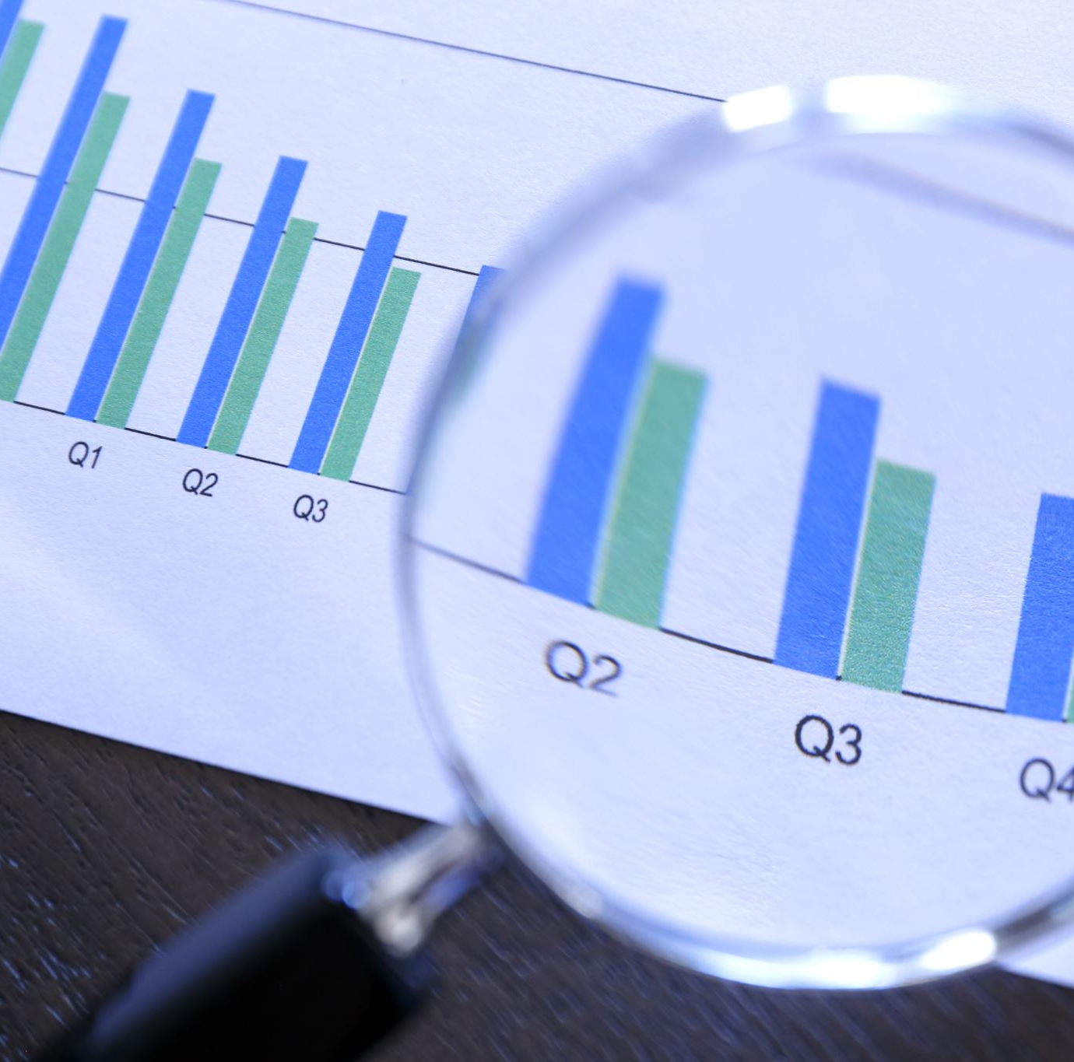
Content
Introduction
Diabetes Overview
Process Flow
Tools and Platform used
Data Collection and Pre-processing
Data Preliminary Analysis
Data Visualization
Machine Learning Algorithms
Model Evaluation
Live data fetching
Conclusion

Slide 3

Introduction
Diabetes is a disease that occurs when your blood glucose, also called blood sugar, is too high.
Hence an early diabetes prediction and management are critical for preventing complications, improving the quality of life, reducing healthcare costs, and empowering individuals to take control of their health.

Slide 4

Diabetes Overview
Type 1 diabetes is an autoimmune disease with an early onset, little to no insulin production, and requires lifelong insulin therapy. Type 2 diabetes is associated with insulin resistance, often occurs in adulthood, and may involve insulin resistance and/or reduced insulin production.
Type 2 diabetes accounts for about 90-95% of all diabetes cases in the U.S.
About 1 in 10 people in the world will have diabetes by 2030, as projected by the International Diabetes Federation.

Slide 5
Dataset Description
Serial No | Attribute Names | Description
1 | Pregnancies | Number of times pregnant
2 | Glucose | Plasma Glucose Concentration
3 | Blood Pressure | Diastolic Blood Pressure
4 | Skin Thickness | Triceps skin fold thickness (mm)
5 | Insulin | 2-h Serum Insulin
6 | BMI | Body mass Index
7 | Diabetes Pedigree Function | Diabetes Pedigree Function
8 | Outcome | Class variable (0 or 1)
9 | Age | Age of Patient

Slide 6
Process Flow
Finding Topic
Searching for related dataset
Data Preprocessing
Data Visualization
Apply Algorithms
Conclusion

Slide 7
Tools and Platform Used
Tool – Python
Platform – Jupiter Notebook
Library Used - Sklearn ,Pandas, NumPy, Seaborn, Matplotlib

Slide 8
Data Collection and Pre-processing
We collected data from a cohort of around 770 female patients
Data pre-processing is a crucial step in the data analysis and machine learning pipeline. It involves cleaning and transforming raw data into a format that is suitable for analysis or modelling. Data pre-processing helps improve the quality of data and ensures that the data is ready for further analysis or training machine learning models
Handling missing data is essential to maintain data quality, ensure the reliability of analyses and models, avoid biases, and comply with ethical and legal standards.
Dataset used : https://www.kaggle.com/uciml/pima-indians-diabetes-database

Slide 9
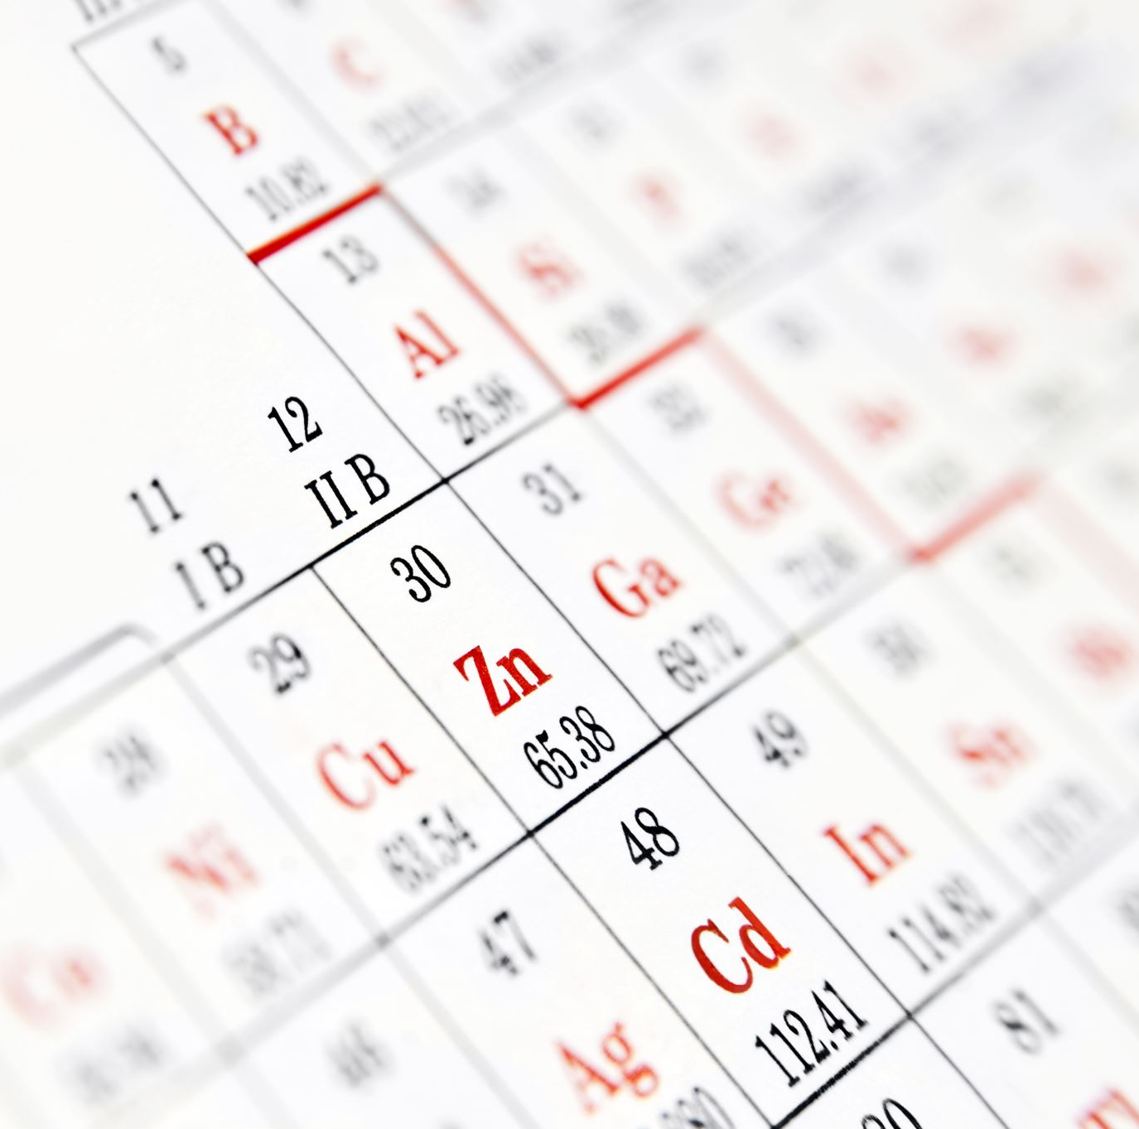
Data Preliminary Analysis
Data Description: The dataset has 9 columns and 769 rows
Duplicate Values: There is no duplicate value in dataset.
Missing Values: There is no Null value in dataset.
Each feature can be either of integer or float dataype.
Some features like Glucose, Blood pressure , Insulin, BMI have zero values which represent missing data.
There are zero NaN values in the dataset.
In the outcome column, 1 represents diabetes positive and 0 represents diabetes negative.

Slide 10
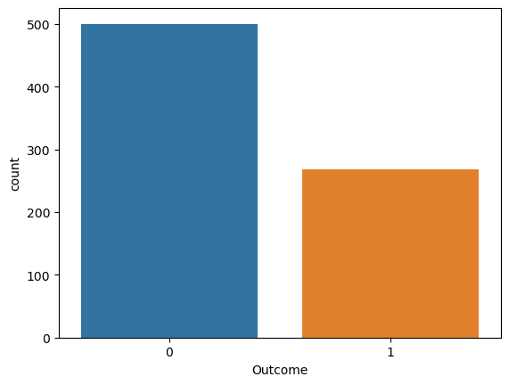
Data Visualization

Slide 11
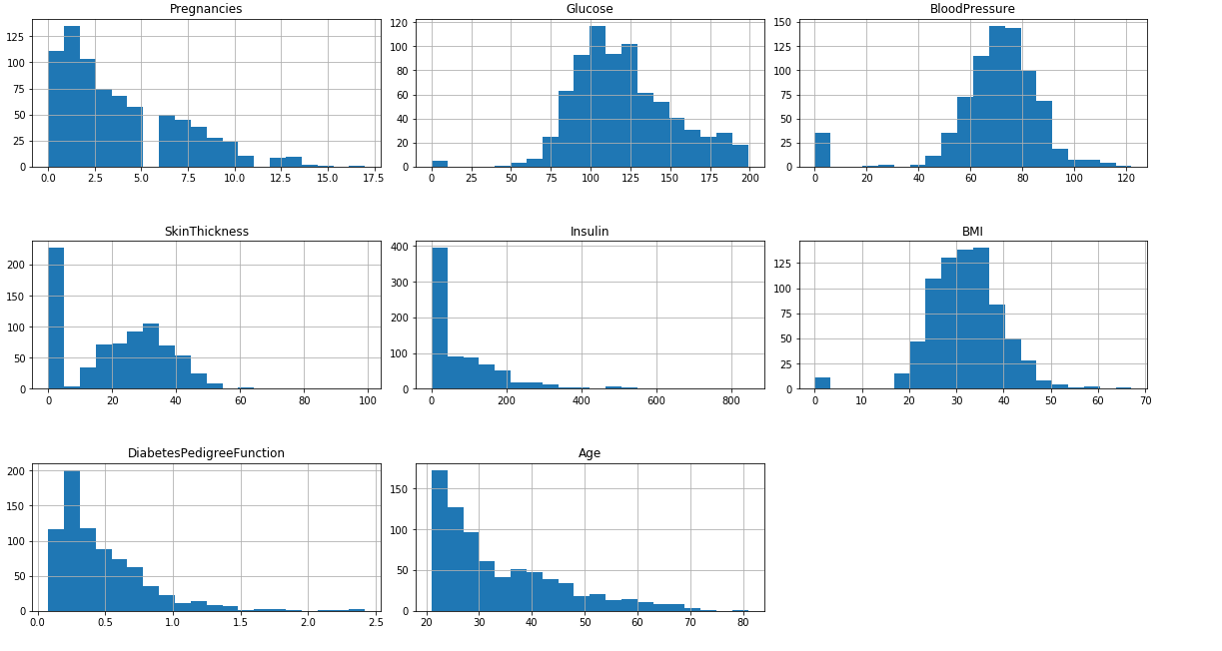
Histogram of each feature

Slide 12
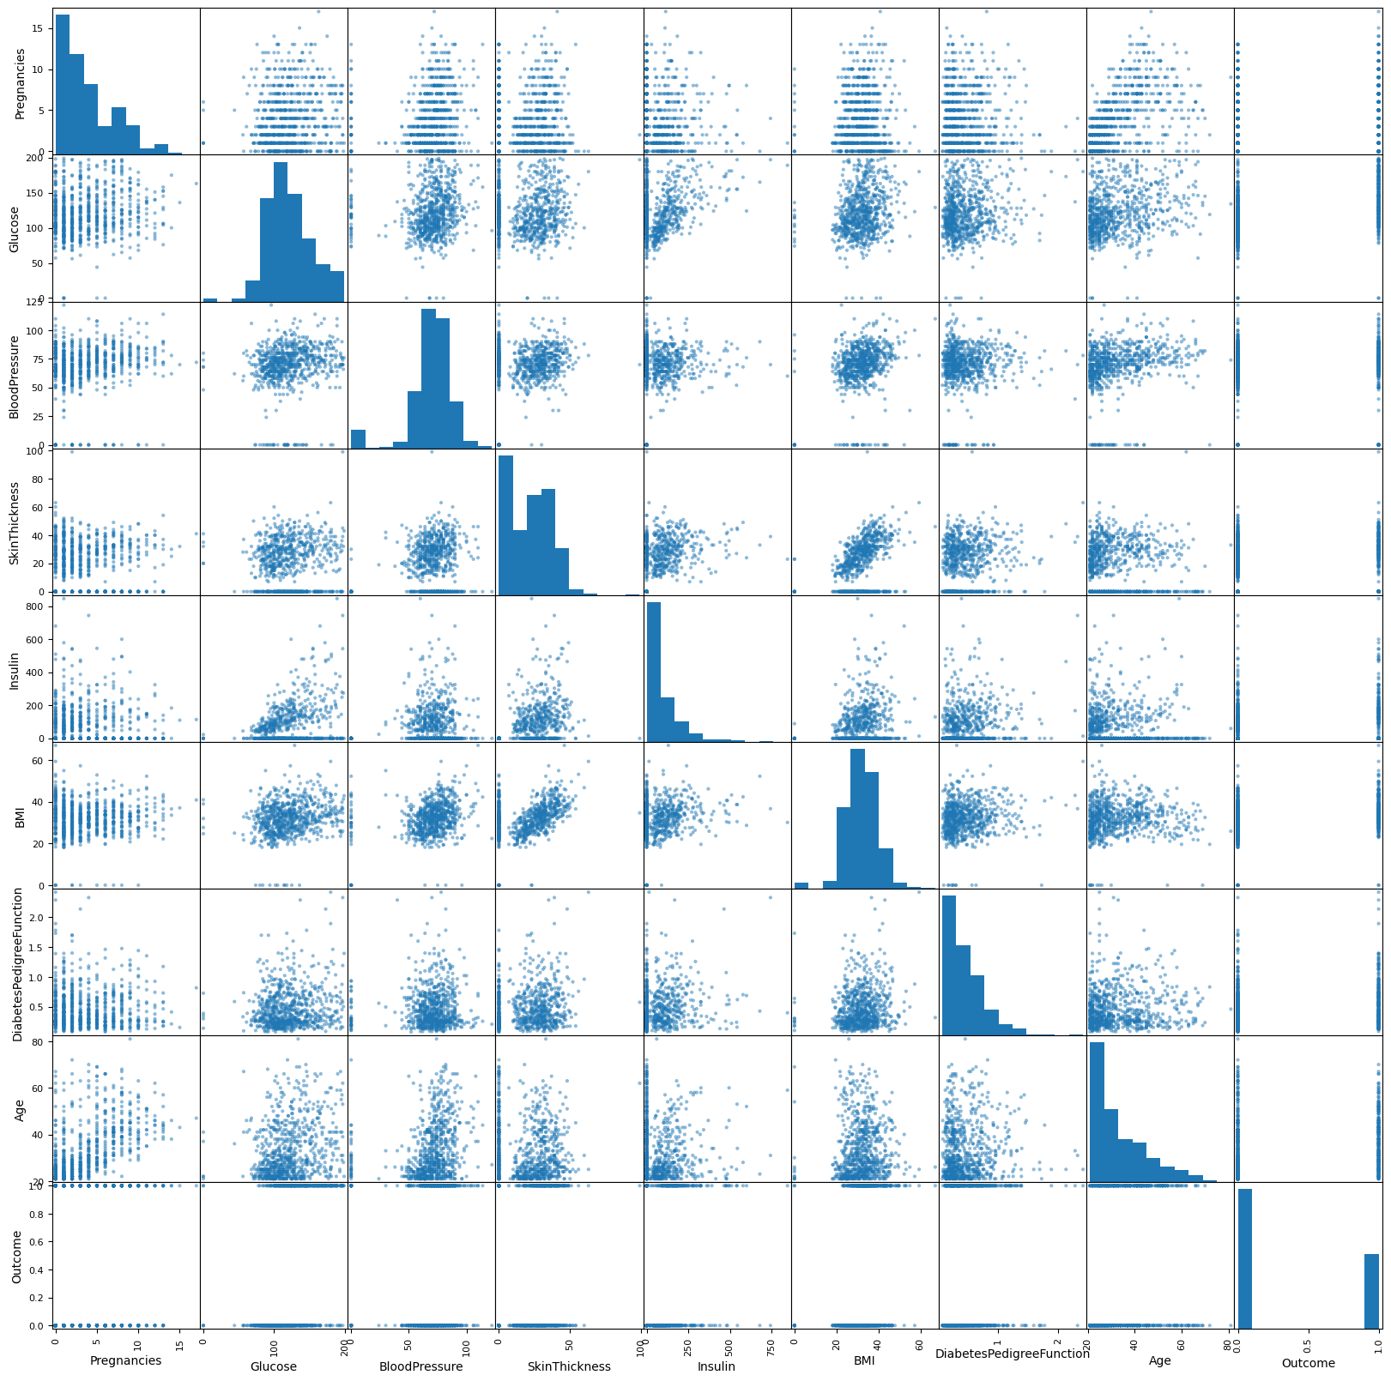
Scatter plot matrix

Slide 13
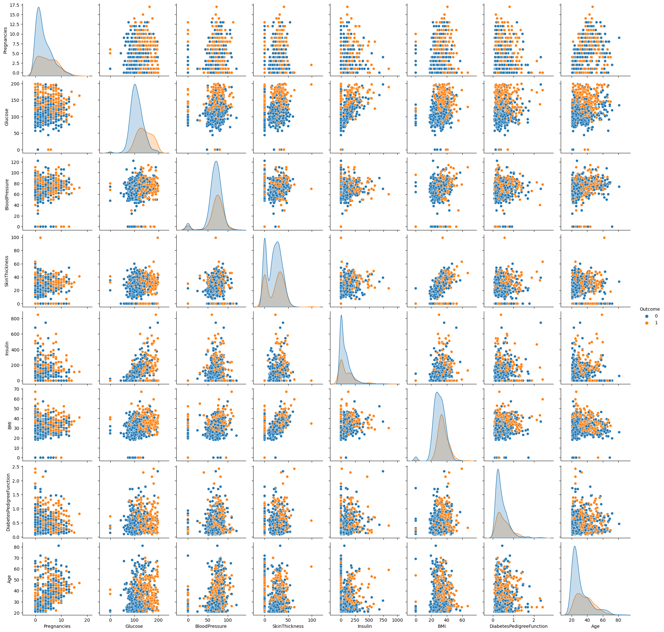
Pair Plot

Slide 14
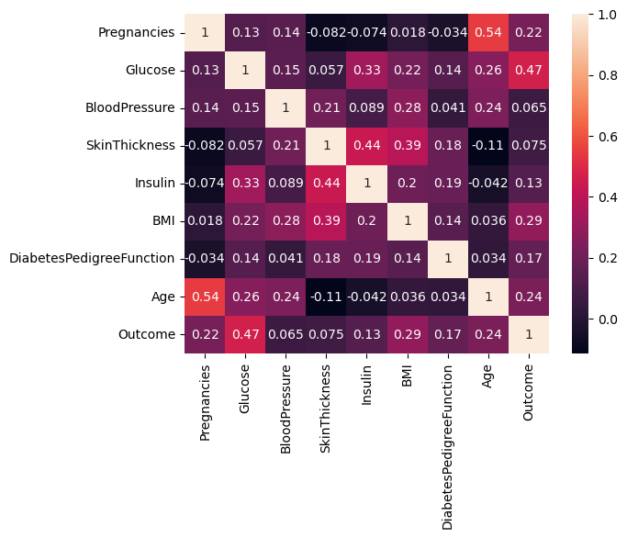

Correlation Matrix

Slide 16
Splitting the Data
Data
X_Train
X_Test
Y_Train
Y_Test

Slide 17
Converting Categorical Variable into Dummy Variable
TARGET VARIABLE
TARGET VARIABLE
Diabetic
(Label Encoder from Sklearn)
1
Non Diabetic
0

Slide 18
Machine Learning Algorithms
1. Logistic Regression
2. Decision Tree Classifier
3. Random Forest Classifier
4. K Neighbor Classifier
5. Support Vector Classifier

Slide 19
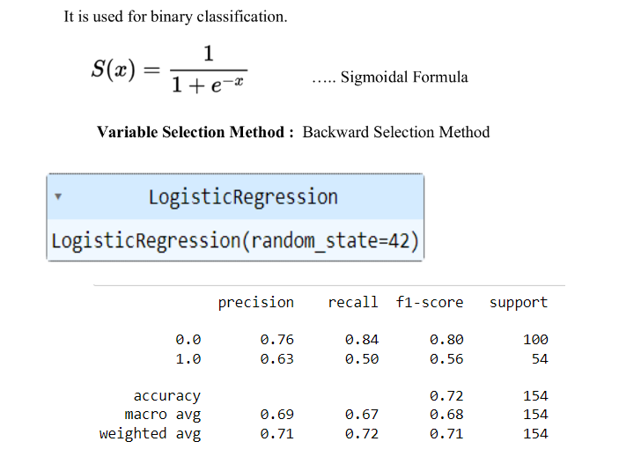
Logistic Regression

Slide 20
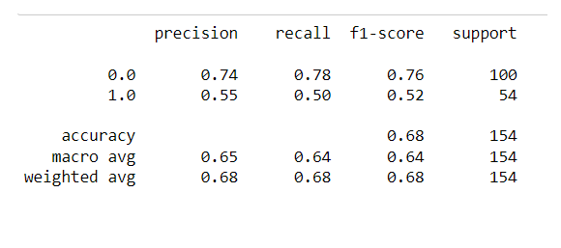
Decision Tree Classifier
A decision tree is a flowchart-like tree structure where each internal node denotes the feature, branches denote the rules and the leaf nodes denote the result of the algorithm

Slide 21
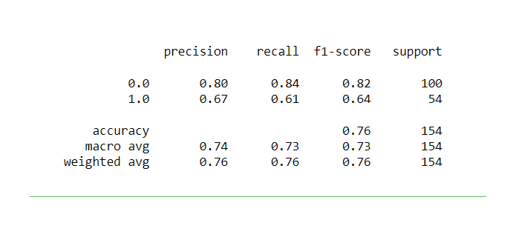
Random Forest Classifier
Random forest classifier combines the output of multiple decision trees to reach a single result. The fundamental idea behind a random forest is to combine many decision trees into a single model.

Slide 22
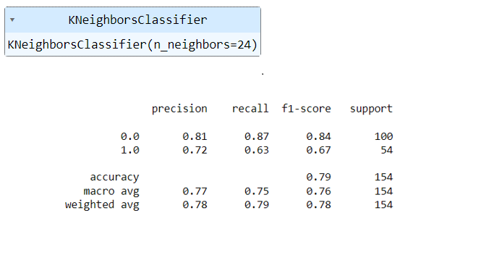
K Nearest Neighbor Classifier
The k value in the k-NN algorithm defines how many neighbours will be checked to determine the classification of a specific query point. For example, if k=1, the instance will be assigned to the same class as its single nearest neighbour. The main aim of KNN is to find the nearest neighbours of our query point.

Slide 23
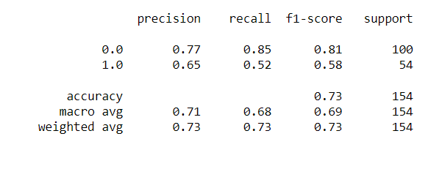
Support Vector Classifier
Support Vector Machines (SVMs) are powerful machine learning models used for classification and regression tasks. They work by finding a hyperplane that best separates different classes of data points.

Slide 24
Modal Evaluation
Logistic Regression: 72.07792207792207
K Nearest neighbors: 78.57142857142857
Support Vector Classifier: 73.37662337662337
Naive Bayes: 71.42857142857143
Decision tree: 68.18181818181817
Random Forest: 75.97402597402598
From the above comparison we can observe that K- Nearest neighbour classifier gets the highest accurancy of 78.57 percent

Slide 25
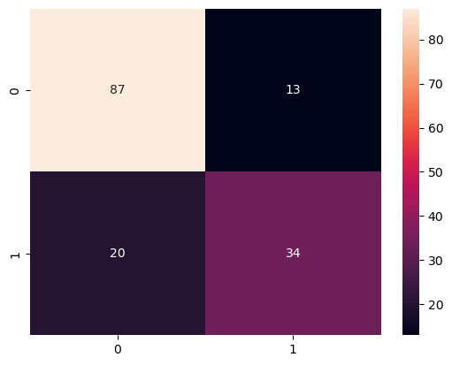
Heat map of confusion matrix

Slide 26
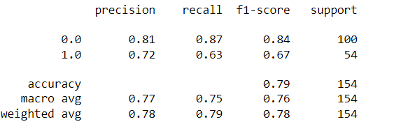
Classification Report

Slide 27
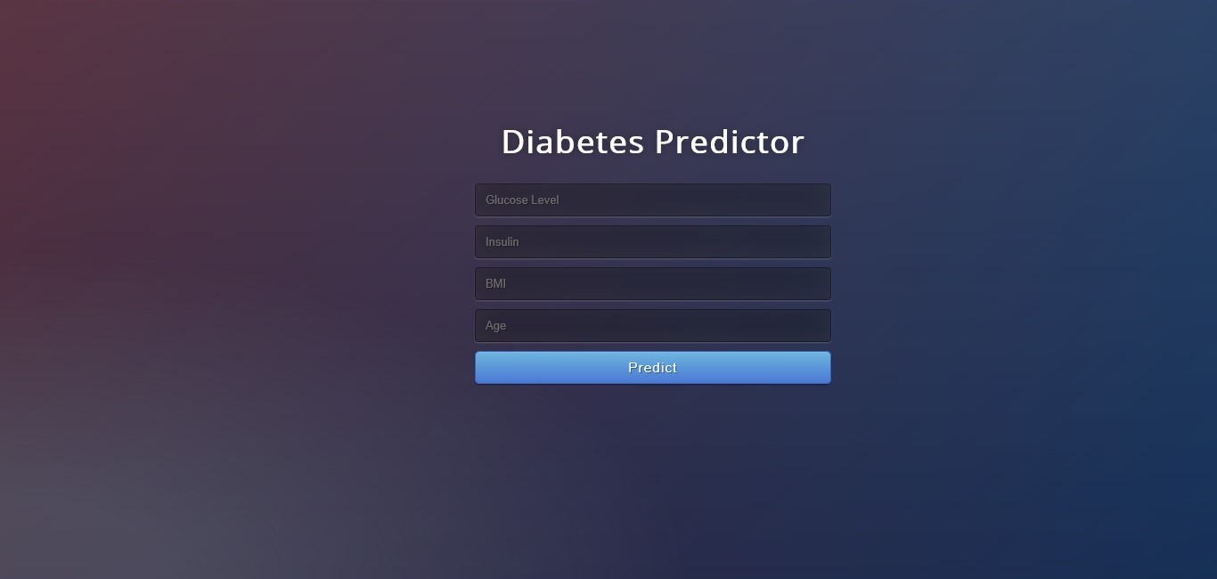
Live data fetching

Slide 28

Conclusion
The objective of the project was to develop a model which could identify patients with diabetes who are at high risk of hospital admission. Prediction of risk of hospital admission is a fairly complex task. Many factors influence this process and the outcome
This project is a small contribution to the present existing methods of diabetes detection by proposing a system that can be used as an assistive tool in identifying the patients at greater risk of being diabetic.

Slide 29

THANK YOU!

